Slide 1

PETROGLOBAL ENERGY VENDOR PERFORMANCE ANALYSIS
??BY ??
NMEHIELLE NDIDI & ELAGAUMA AIMANOSHI

Slide 2

AGENDA
Project description
Vendor performance rankings
Data Quality assessment
Quality issues by category
Vendor portfolio key metrics
Does contract size affect quality
Spend by vector category
Predicting on time delivery performance
Regional Vendor Performance
Executive summary
Contract type performance analysis
Quality vs Safety compliance
Quality vs Safety correlation equation

Slide 3
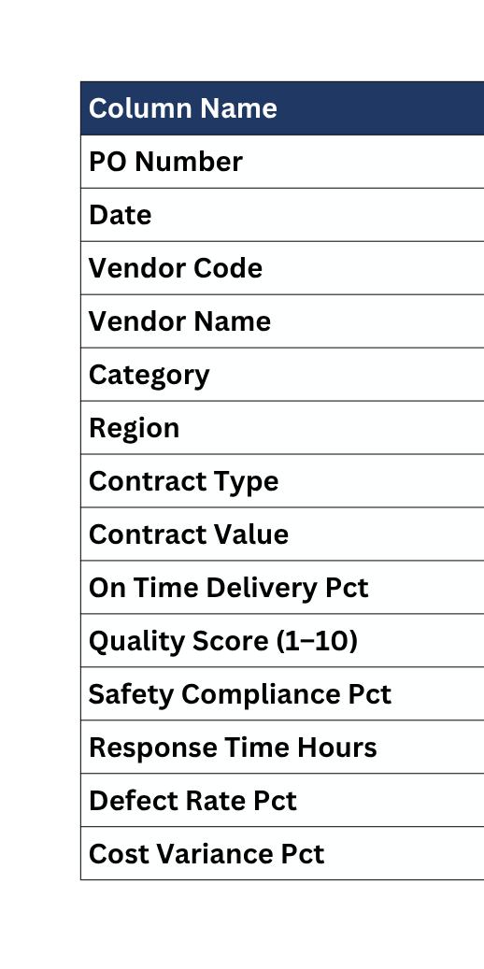
PROJECT DESCRIPTION
Legend Table
PetroGlobal Energy, an oil and gas company. The objective of this anylsis is to evaluate vendor reliability, quality, safety compliance, and cost-effectiveness to improve overall vendor performance

Slide 4
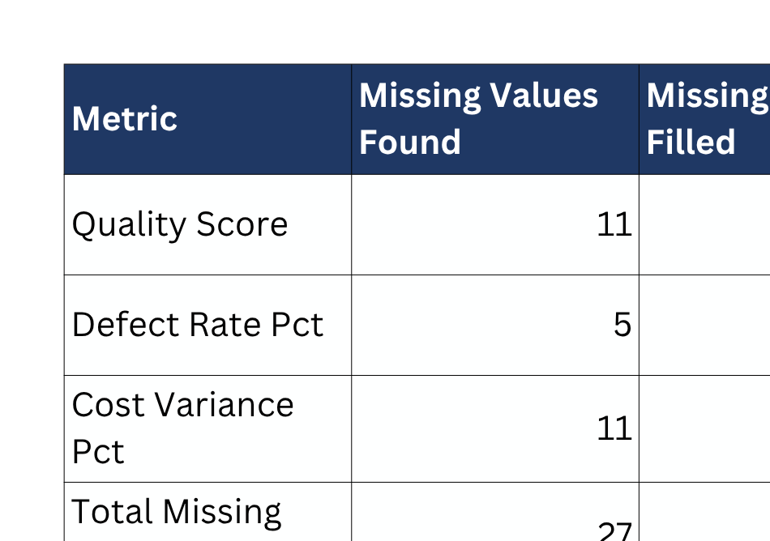
DATA QUALITY ASSESSMENT
THE DATA WAS CLEANED AND STANDARDIZED AS INSTRUCTED AND THE MISSING VALUES WERE INPUTTED USING AVERAGE FUNCTION OF EACH SPECIFIC COLUMN RESULTING IN 220 VENDOR RECORDS.

Slide 5
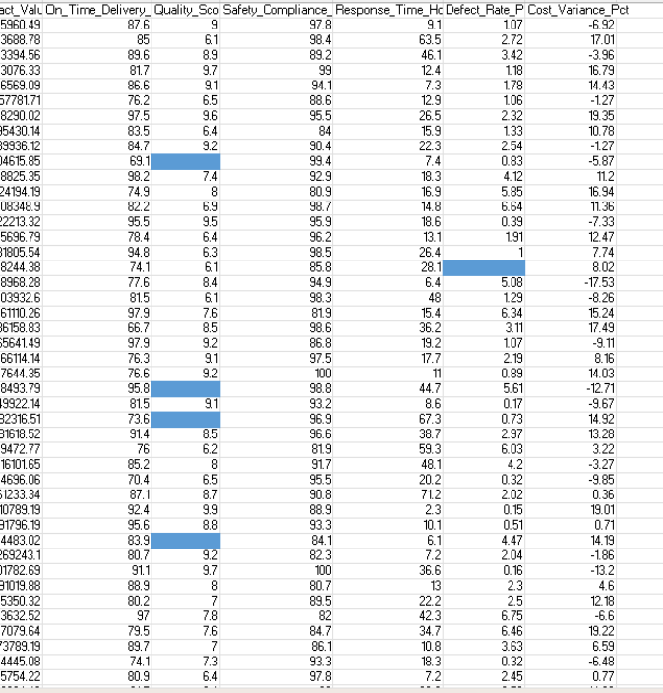
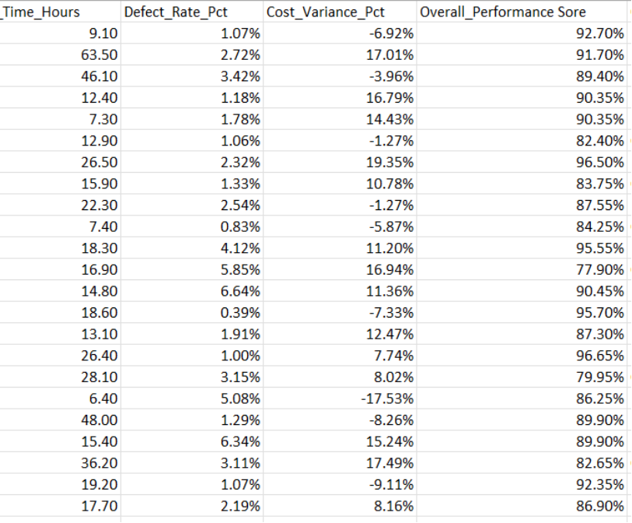
FIG 1. SCREENSHOT SHOWING CONDITIONAL FORMATTING OF BLANK CELLS
NB=OVERALL PERFORMANCE =(ON TIME DELIVERY PCT +SAFETY COMPLIANCE PER )/2
FIG 1.1 SCREENSHOT SHOWING NEW OVERALL PERFORMANCE SCORE

Slide 6
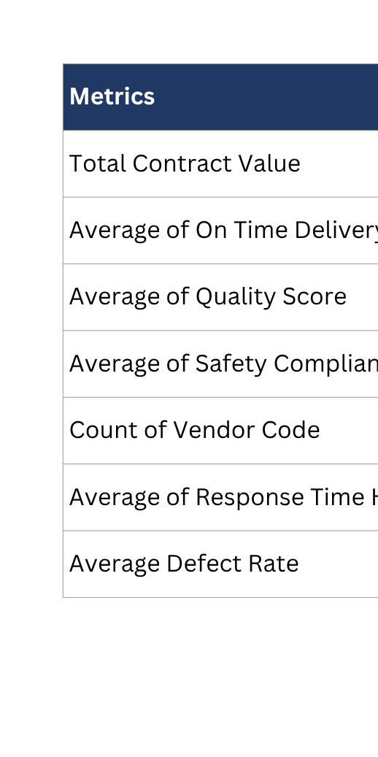
VENDOR PORTFOLIO KEY METRICS
This shows that the overall vendor performance is strong with high safety performance, moderate on time delivery and defect rates. However, the response time variability presents opportunity for operational improvement.

Slide 7
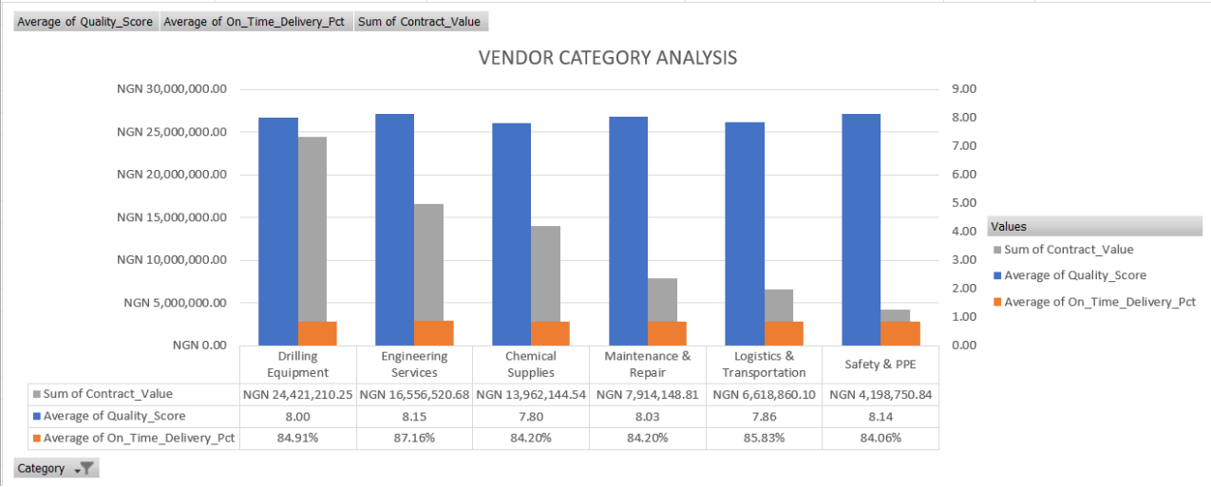
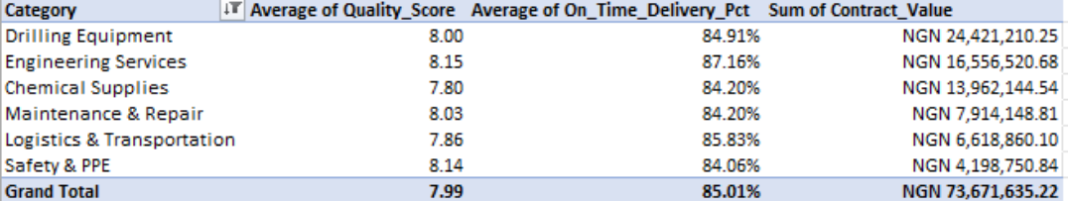
SPEND BY VENDOR CATEGORY
DRILLING EQUIPMENT IS THE HIGHEST SPEND CATEGORY
ENGINEERING SERVICES HAS THE BEST QUALITY PERFORMANCE

Slide 8
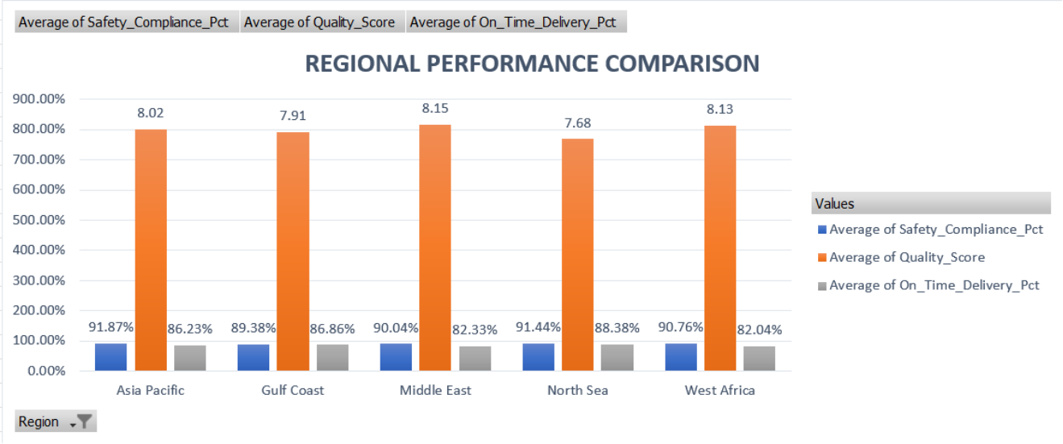
REGIONAL VENDOR PERFORMANCE
NORTH SEA REGION IS THE MOST RELIABLE REGION BECAUSE IT HAS THE HIGHEST ON TIME DELIVERY: 88.38%.

Slide 9
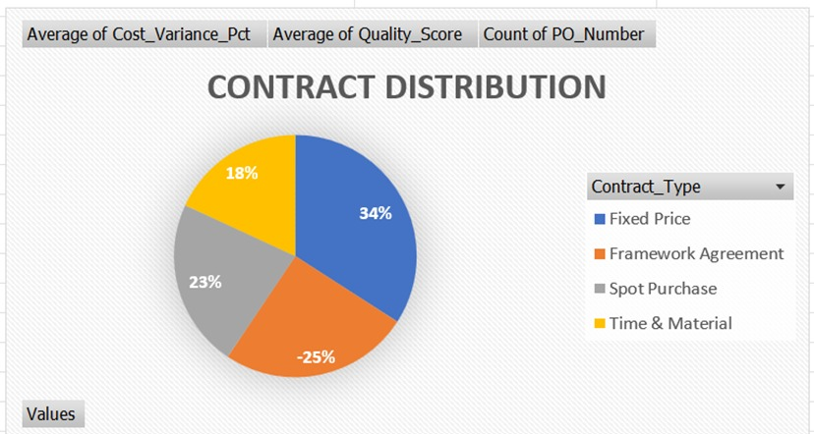
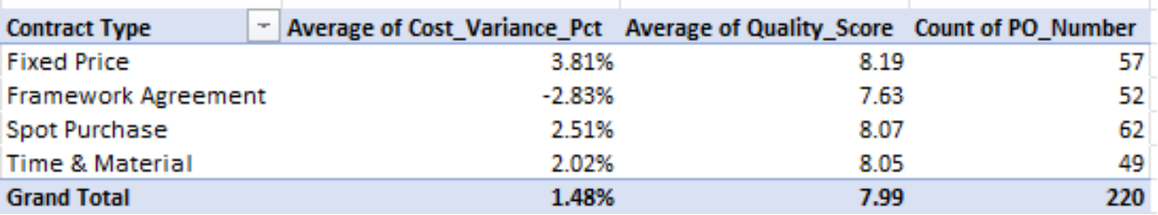
CONTRACT TYPE PERFORMANCE ANALYSIS
FRAMEWORK AGREEMENT PROVIDES THE BEST VALUE BECAUSE IT HAS A NEGATIVE COST VARIANCE SHOWING THE CONTRACT IS UNDER BUDGET.
WHICH SHOWS STABLE PERFORMANCE.

Slide 10
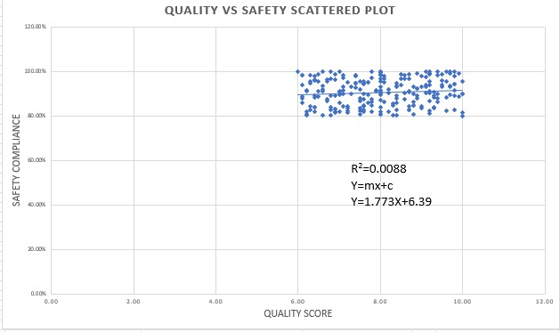
QUALITY VS SAFETY CORRELATION
CORRELATION (R)=0.094. THIS SHOWS A VERY WEAK POSITIVE CORRELATION
R2=0.0088 MEANING A VARIATION OF JUST 0.88%.
MEANING QUALITY SCORE DOES NOT STRONGLY DEPEND ON SAFETY COMPLIANCE

Slide 11
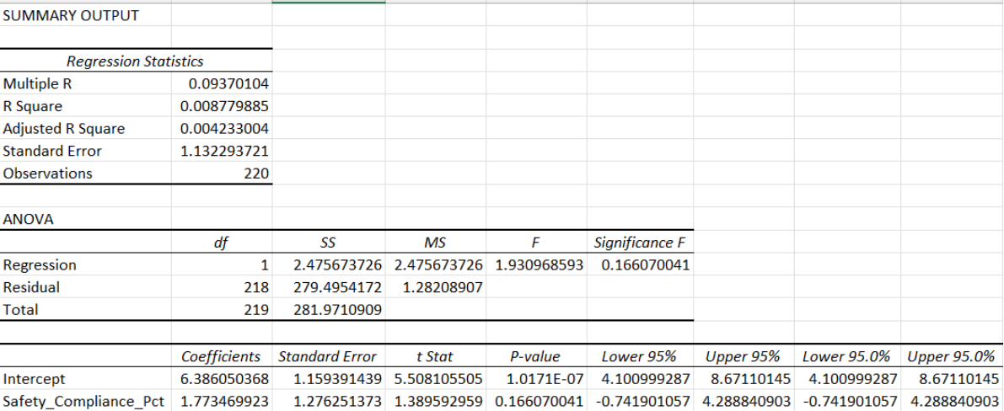
QUALITY VS SAFETY CORRELATION AND EQUATION

Slide 12
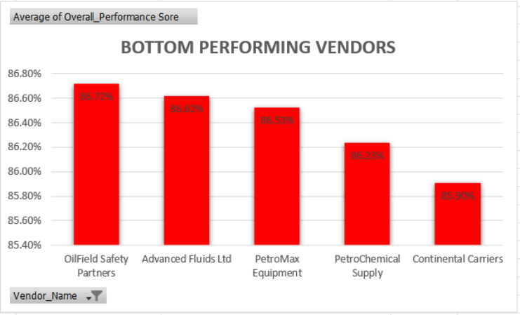
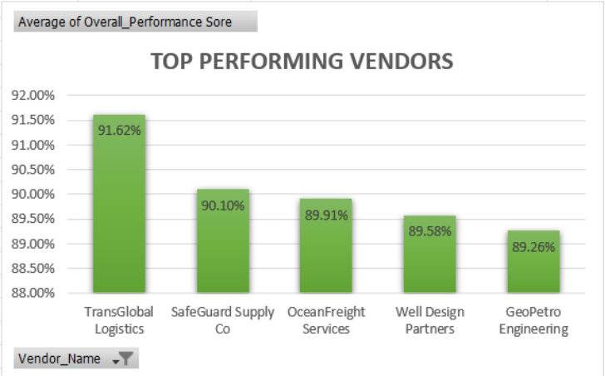
VENDOR PERFORMANCE RANKINGS
RECOMMENDATION
TOP VENDORS SHOULD BE PRIORITIZED FOR CONTRACT EXPANSION
BOTTOM VENDORS REQUIRE PERFORMANCE REVIEW OR CORRECTIVE PLANS

Slide 13
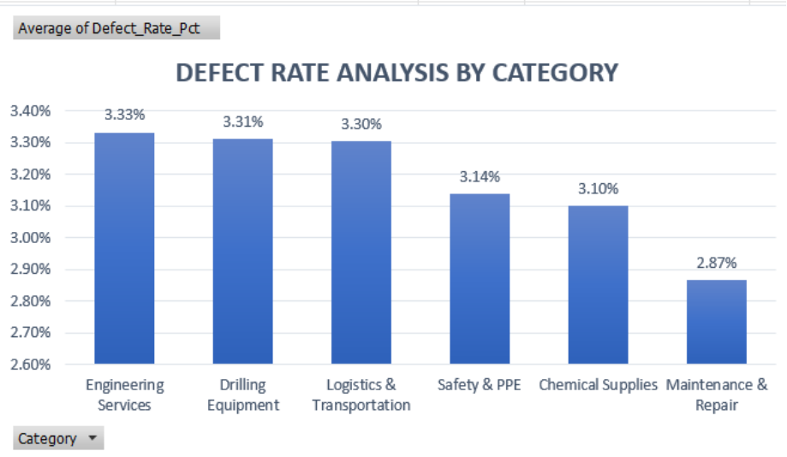
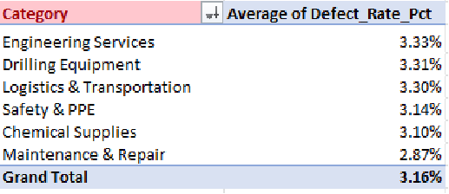
QUALITY ISSUES BY CATEGORY
OVERALL PRODUCT/SERVICE QUALITY IS STRONG SINCE NO CATEGORY PASSED 5% WITH AN OVERALL OF 3.16%.
VENDORS ARE MAINTAINING ACCEPTABLE DEFECT THRESHOLDS
THERE IS NO HIGH RISK QUALITY CATEGORY

Slide 14
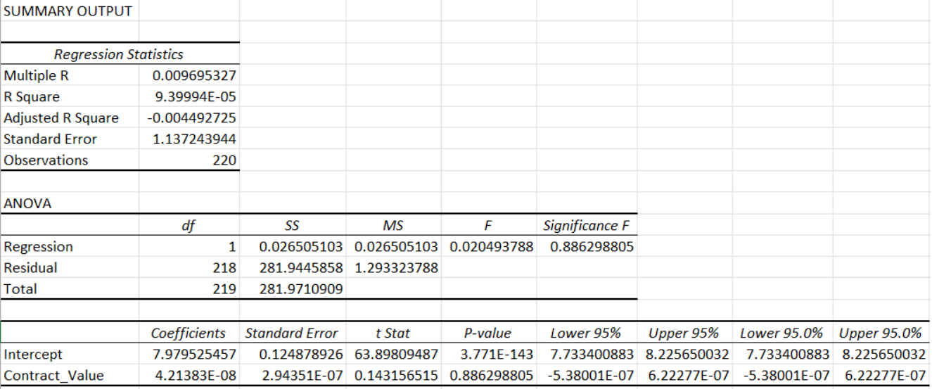
DOES CONTRACT SIZE AFFECT QUALITY

Slide 15
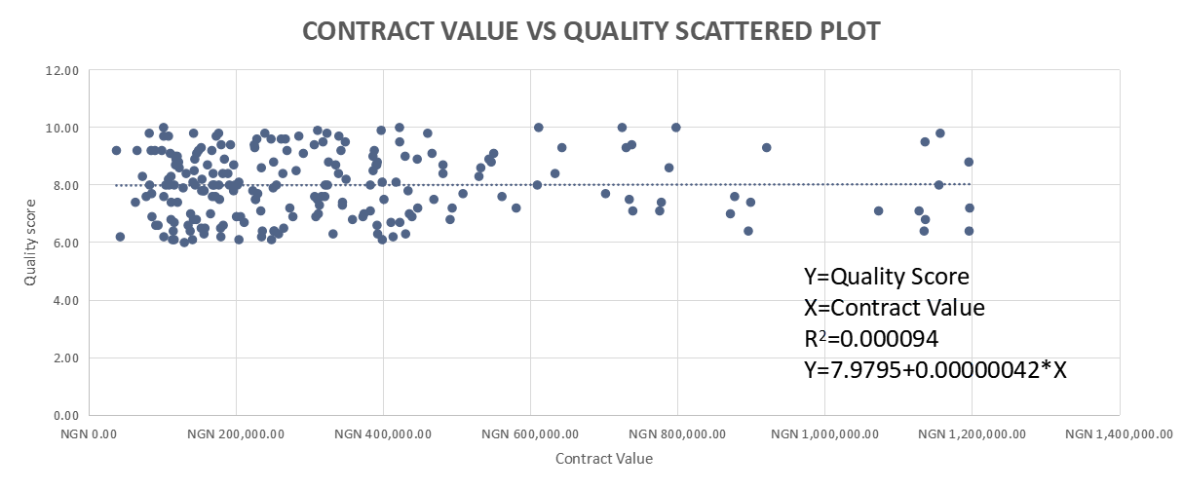
CONTRACT VALUE VS QUALITY SCATTERED PLOT
THE REGRESSION ANALYSIS INDICATES AN EXTREMELY WEAK RELATIONSHIP BETWEEN THE CONTRACT SIZE AND VENDOR QUALITY PERFORMANCE. SINCE R2=0.000094
THE CONTRACT VALUE ALSO DOES NOT PREDICT QUALITY OUTCOME
THIS INDICATES THAT PETROGLOBAL SELECTS VENDORS BASED ON CAPACITY.

Slide 16
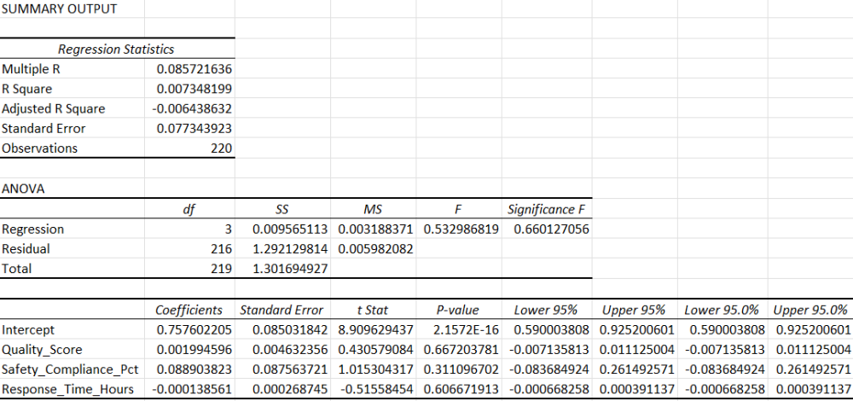
PREDICTING ON-TIME DELIVERY PERFORMANCE
X1=QUALITY SCORE,
X2=SAFETY COMPLIANCE
X3= RESPONSE TIME
Y= ON TIME DELIVERY
ONTIME DELIVERY =0.001995X1+0.0889X2-0.000139X3+0.7576
R2=0.0073(0.73%)
THIS SHOWS THAT SAFETY HAS THE HIGHEST POSITIVE INFLUENCE ON TIME DELIVERY.
THE RESPONSE TIME NEGATIVELY AFFECTS DELIVERY SO IT NEED TO BE LOOKED INTO
NB: THE R2=0.0073 INDICATES THAT THE MODEL IS VERY WEAK BECAUSE IT HAS A LESS THAN 1% VARIATION IN ON-TIME DELIVERY PERFORMANCE, SHOWING THAT THEY ARE WEAK PREDICTORS.

Slide 17
EXECUTIVE SUMMARY AND STRATEGIC RECOMMENDATIONS
PetroGlobal maintains strong vendor quality and safety performance, but delivery reliability requires improvement, indicating operational rather than vendor-related challenges.
Improve on-time delivery
Reward Good Vendors, Train/Replace Bad Ones
The data shows that quality, safety, and response time together explain less than 1% of delivery performance (R² = 0.007). That means the problem is not the vendors, it's internal planning and coordination. Review how operations are scheduled and managed.
TransGlobal Logistics is the top performer with a score of 91.62. Continental Carriers is last at 85.90 in logistics, where delivery is the entire job. Expand contracts with the top 5 vendors. Give the bottom performers 90 days to improve or replace them.
Use More Framework Agreements
Learn From the Best Region
Framework Agreements come in 3.09% under budget on average. Fixed Price contracts run 4.03% over. Switching more contracts to Framework Agreements could save PetroGlobal between ₦6.75 billion and ₦9.45 billion per year (approximately $5M–$7M at today's rate of ₦1,350/$1).
North Sea has the best on-time delivery at 88.4%. West Africa (82%) and Middle East (82.3%) are more than 6 points behind. Find out what North Sea is doing right and apply it to every other region.

Slide 18
Thank you!

